Slide 1

Khulna University of Engineering & Technology
Department of Computer Science and Engineering
Project Report
QSync - Queue Management System
Name : Mutiur Rahman
Roll : 220797
Year : Second
Term : Second
Course No : CSE 2200
Course Name : Advance Programming Laboratory
Date of Submission : 14/01/2026
(Desktop)

Slide 2
QSync - Queue Management System
Project Description
QSync is a comprehensive Desktop-based queue management system designed for those facilities to streamline appointment scheduling and queue management. The application provides a dual-interface solution with separate portals for patients and administrators, enabling efficient management of departments, doctors, and patient queues in real-time.
Key Features
Dual User Interface: Separate portals for patients and administrators
Real-time Queue Management: Live tracking of patient queues across departments
Database Integration: Secure authentication and SQLite database synchronization.
Department & Doctor Management: Admin tools to manage healthcare providers
Priority-based Queuing: Support for normal, urgent, and emergency appointments
User Profiles: Personalized user accounts with appointment history
Project Details
System Architecture
QSync Desktop is built on a modular architecture that emphasizes reliability and performance:
Core Technologies
Java: Developed using Java 25, leveraging modern language features for performance and safety.
JavaFX: Utilizes JavaFX 21 for the graphical user interface, providing a smooth and responsive desktop experience.
SQLite: Uses SQLite 3 for local data persistence, ensuring fast access without the need for a separate database server.
Design Patterns
Model-View-Controller (MVC): Decouples business logic from the user interface, allowing for independent development and testing of each component.
Data Access Object (DAO): Provides an abstraction layer for database operations, ensuring that the application logic remains independent of the storage mechanism.
Service Layer: Encapsulates core business processes (e.g., appointment scheduling, session management) to ensure code reusability and consistency.

Slide 3
Database Design
The application uses an embedded SQLite database (qsync.db) with a strictly enforced relational schema:
Authentication Tables:
users: Stores patient profile information.
admins: Stores administrative credentials.
Security: All passwords are stored as cryptographic hashes (SHA-256).
Healthcare Hierarchy:
departments: Categorizes medical services.
doctors: Profiles medical staff with associations to specific departments.
Queue Management:
appointments: The core table tracking patient tokens, schedules, and various statuses (Waiting, In Progress, Completed, Cancelled).
Data Integrity: Implemented using foreign key constraints and triggered timestamps.
Authentication System
User Login & Registration: Email/password authentication via Local Auth
Admin Login: Separate admin authentication portal with role-based access control
Auto-login: Automatic session management with token refresh
Role Detection: RBAC (Role Bases Access Control) for admin and user login
User Portal
Implemented a complete patient-facing interface with Sidebar navigation:
Home Fragment: Dashboard displaying overview of all data.
Join Fragment:
Department and doctor selection
Priority level selection (Normal, Urgent, Emergency)
Symptoms/reason for visit input
Estimated wait time calculation
Queue position preview
History Fragment: View past appointments and queue history
Profile Fragment: User profile management and settings
Sidebar: A sidebar for navigating to all pages and also a sign out button at the bottom.

Slide 4
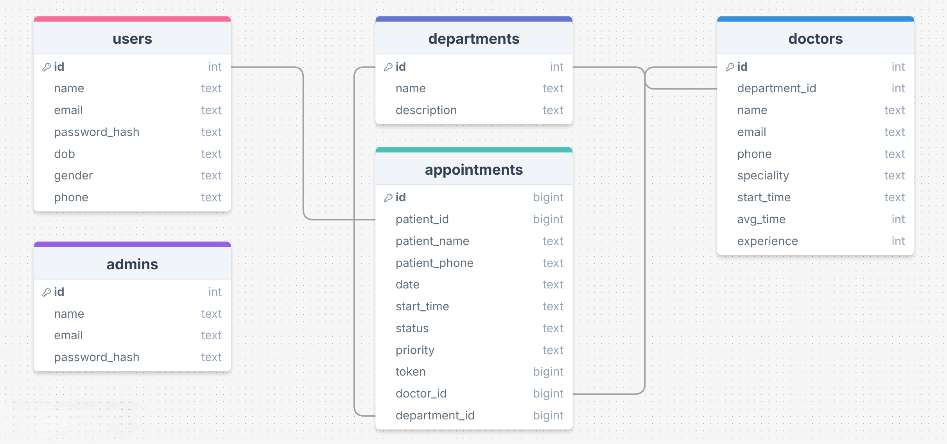
Admin Portal
Comprehensive administrative dashboard with:
Admin Home:
Live queue monitoring with expandable tree view
Real-time status updates (Waiting, In Progress, Completed, Cancelled)
Department and doctor-wise queue organization
Manage Fragment: Central hub for administrative tasks
Department management (Add, Edit, Delete)
Doctor management (Add, Edit, Delete with department assignment)
Admin Profile: Admin account settings and logout functionality
Completed Fragment: Archive of completed appointments
Sidebar: A sidebar for navigating to all pages and also a sign out button at the bottom.
Data Models
User: Patient information model
Department: Healthcare department structure
Doctor: Doctor profiles with department associations
Queue: Appointment queue items with status tracking
Tech Stack
Java
JavaFX (Design)
Maven (Build)
SQLite (Database)
Database Schema

Slide 5
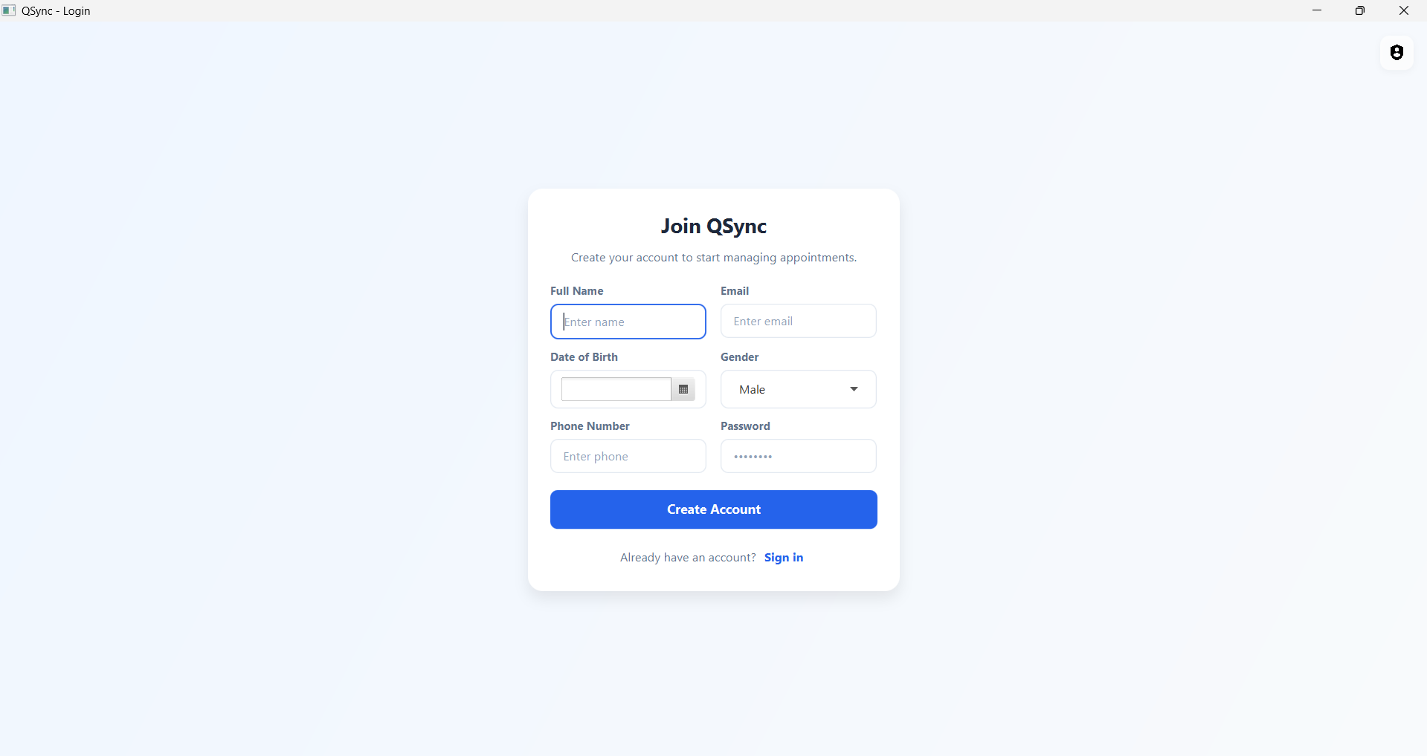
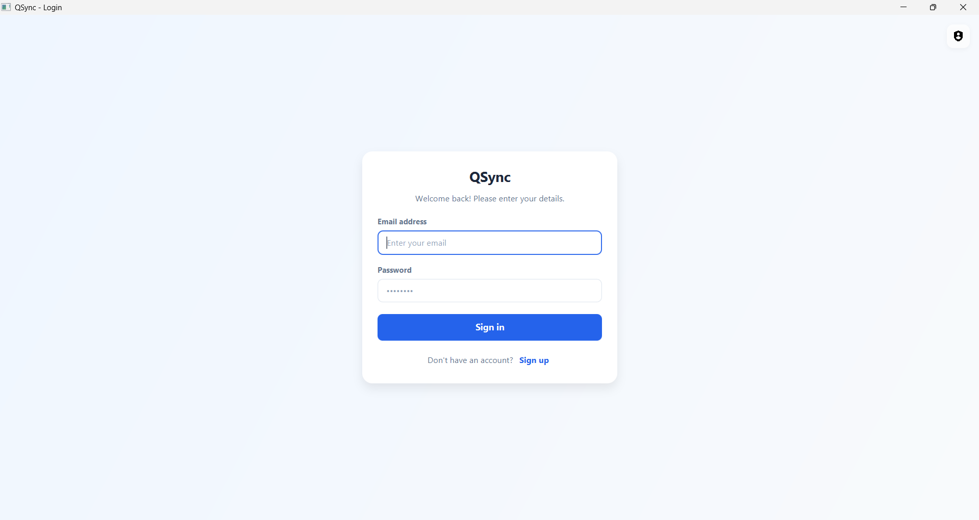
User Registration
User Login

Slide 6
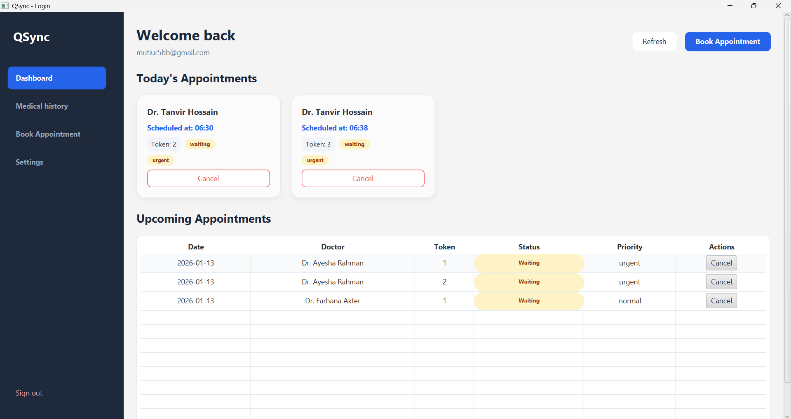
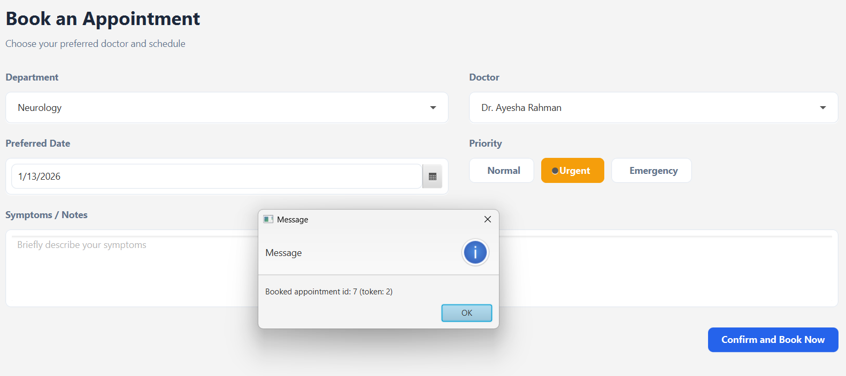

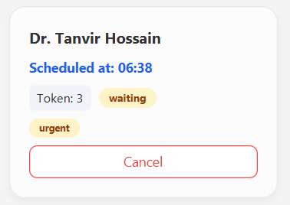
User Dashboard
Queue Joining

Slide 7
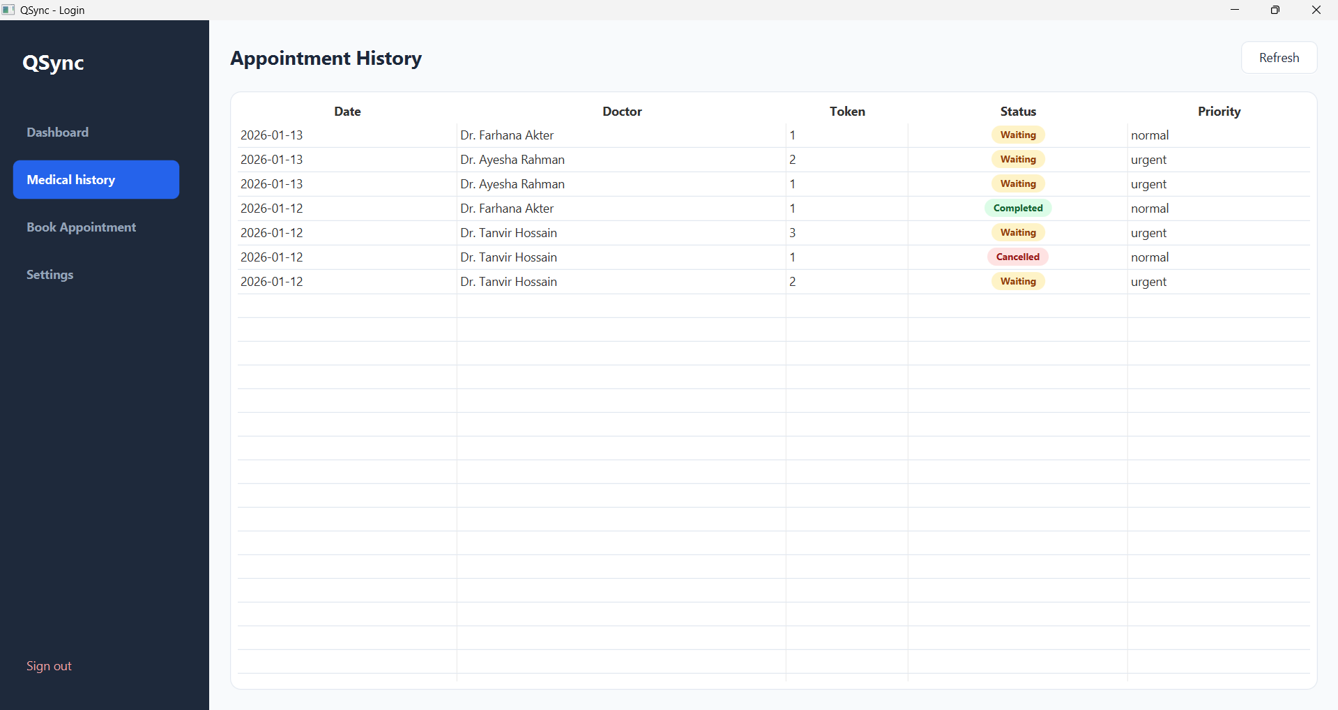
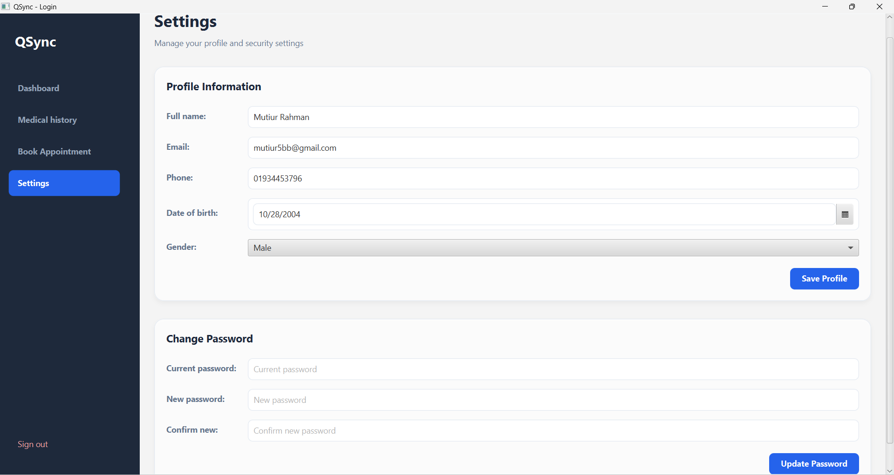
Appointment History
Profile

Slide 8
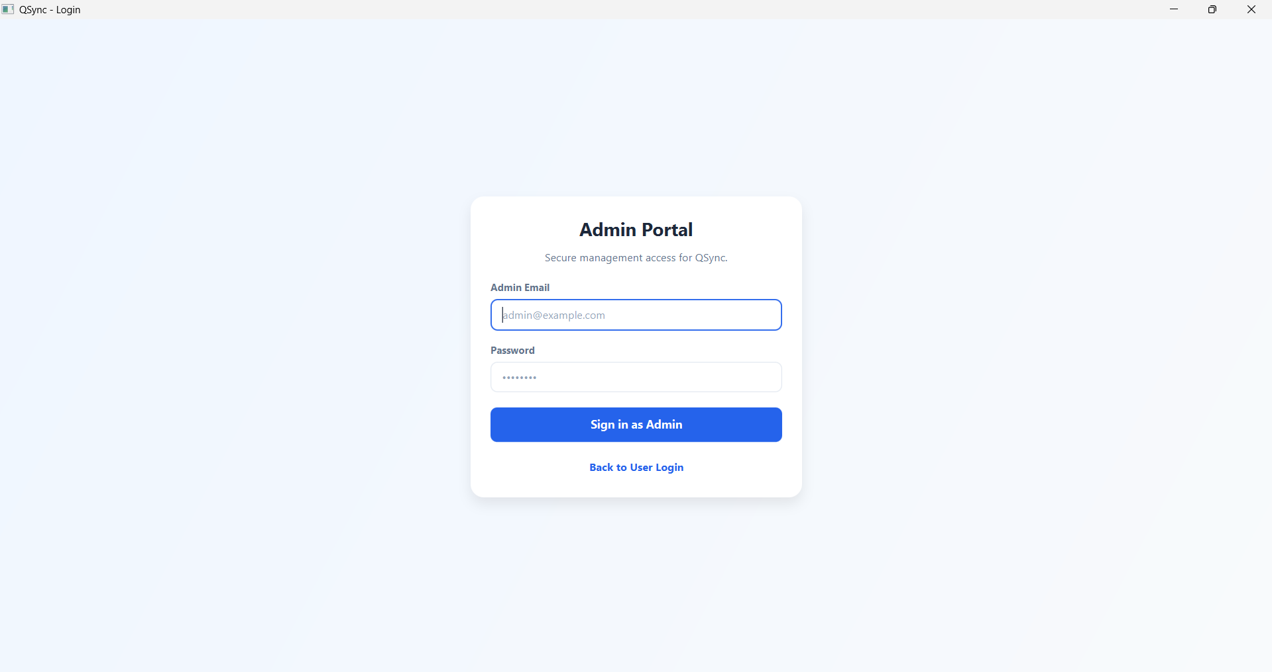
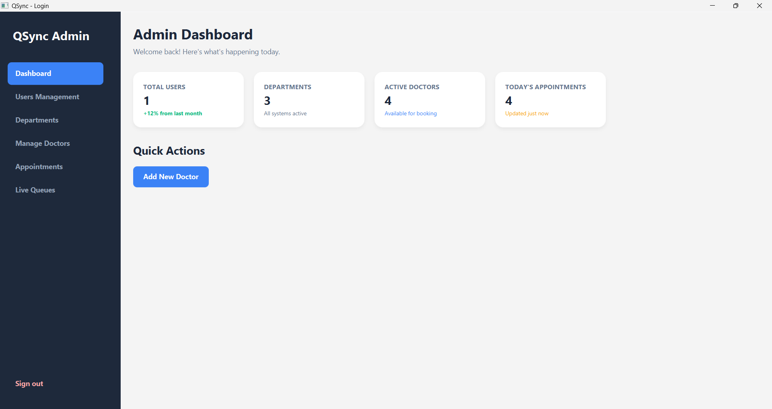
Admin Login
Admin Dashboard

Slide 9
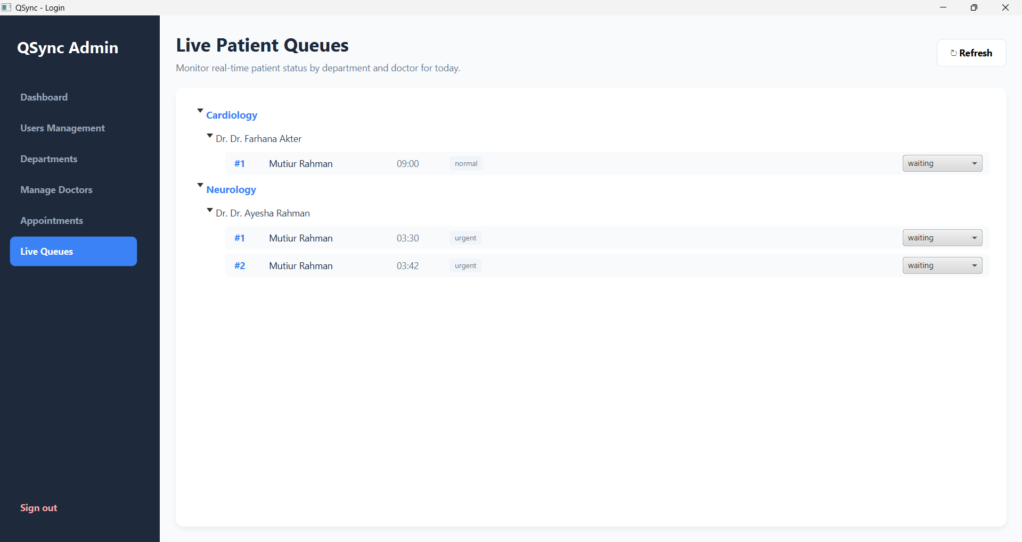
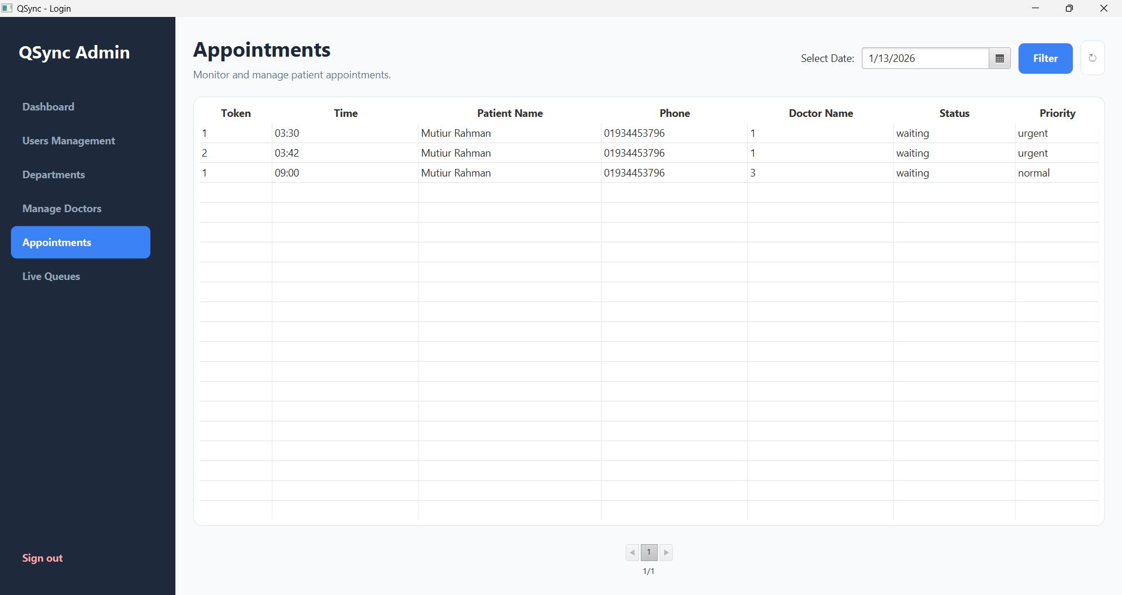
Todays Queues
Appointment History

Slide 10
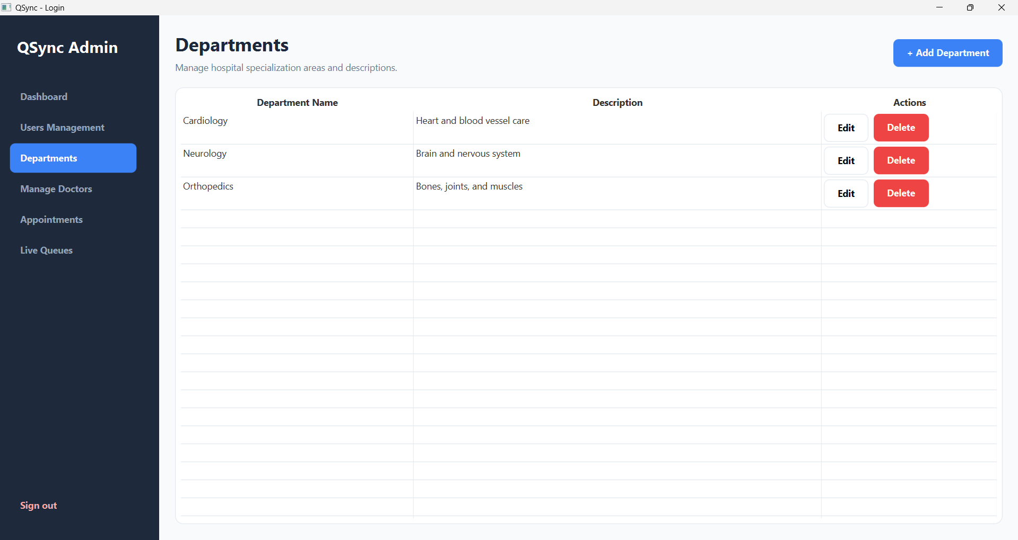
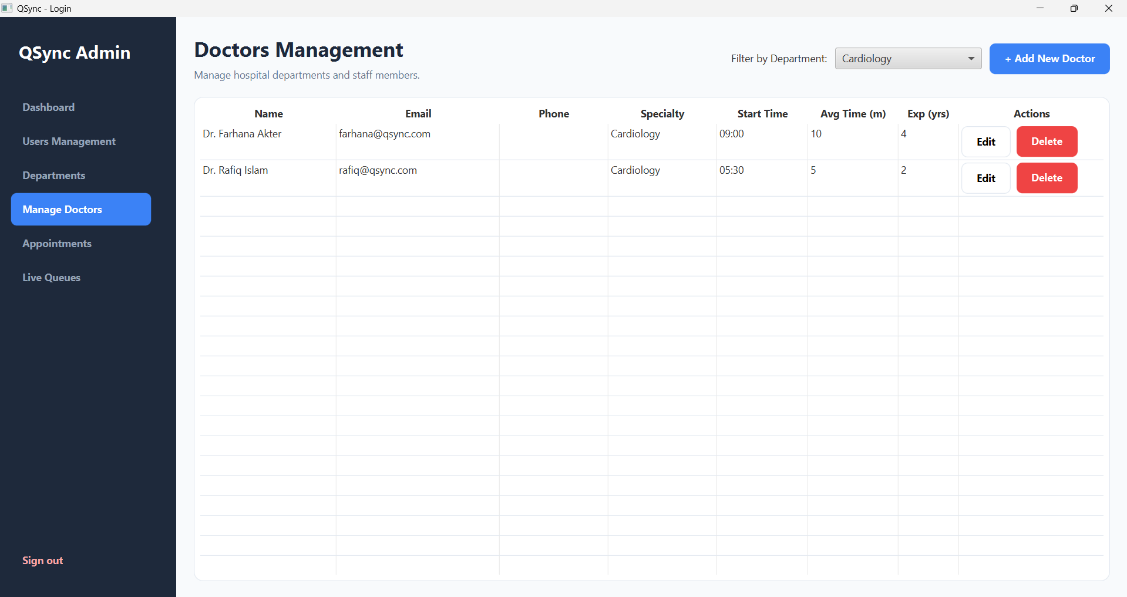
Department Management
Doctor Management

